Slide 1
Restoring the City
Umamah Hussain 21L-1858
Manal Abdul Razzaq 21L-5250
A Story of Innovation and Resilience

Slide 2
Table of Contents
Introduction
Pix4D technology
Skills Contribution
Practical Advice
Notes:
Imagine waking up to find an entire city reduced to rubble. This was the reality after a massive earthquake struck, flattening neighborhoods and crippling vital infrastructure. The devastation was overwhelming, and the city faced both immediate relief efforts and long-term rebuilding challenges.
In response, the government formed a specialized task force, bringing together the nation’s top architects and urban planners. Their mission was not just to rebuild but to reimagine the city—making it stronger and more resilient to future disasters.
To achieve this ambitious goal, the team turned to cutting-edge technology, specifically AI-powered tools from Pix4D, which allowed them to assess damage, plan restoration, and design for a safer future. This innovative approach highlights the blend of human expertise and advanced technology in overcoming such monumental challenges.

Slide 3
Introduction

Slide 4
Introduction
Disaster Strikes: A massive earthquake devastates a major city, leaving widespread destruction. Entire neighborhoods are flattened, vital infrastructure is damaged, and the city faces both immediate and long-term challenges.
Task Force Formation: Government forms a special team of top architects and urban planners to lead the restoration effort.
Use of Advanced Technology: The team utilizes AI-driven tools from Pix4D for efficient assessment and reconstruction.
The government's priority is to restore the city quickly while making it more resilient to future disasters.
Notes:
Imagine waking up to find an entire city reduced to rubble. This was the reality after a massive earthquake struck, flattening neighborhoods and crippling vital infrastructure. The devastation was overwhelming, and the city faced both immediate relief efforts and long-term rebuilding challenges.
In response, the government formed a specialized task force, bringing together the nation’s top architects and urban planners. Their mission was not just to rebuild but to reimagine the city—making it stronger and more resilient to future disasters.
To achieve this ambitious goal, the team turned to cutting-edge technology, specifically AI-powered tools from Pix4D, which allowed them to assess damage, plan restoration, and design for a safer future. This innovative approach highlights the blend of human expertise and advanced technology in overcoming such monumental challenges.

Slide 5
Pix4D technology
Notes:
Professional photogrammetry and drone mapping software.
Pix4D is a Swiss software company that specializes in terrestrial and drone photogrammetry mapping software.

Slide 6
Pix4Dsurvey
Purpose: Creates detailed 3D models of the damaged terrain.
Data Integration: Combines LiDAR data and aerial photographs.
Capabilities:
Highlights destruction such as cracked roads, collapsed buildings, and unstable foundations.
Provides a clear visualization of the earthquake's impact.
Impact: Serves as the foundation for planning restoration efforts.
Notes:
To begin the restoration process, the team needed a comprehensive understanding of the damage. That’s where Pix4Dsurvey played a crucial role.
This advanced tool creates detailed 3D models of the terrain, offering an accurate representation of the devastation. By integrating data from LiDAR and aerial photographs, it highlights key areas of destruction—cracked roads, collapsed buildings, and unstable foundations.
What makes Pix4Dsurvey invaluable is its ability to provide a clear, visual representation of the earthquake’s impact. This serves as the foundation for planning restoration efforts, enabling the team to prioritize and strategize effectively from the very beginning.

Slide 7
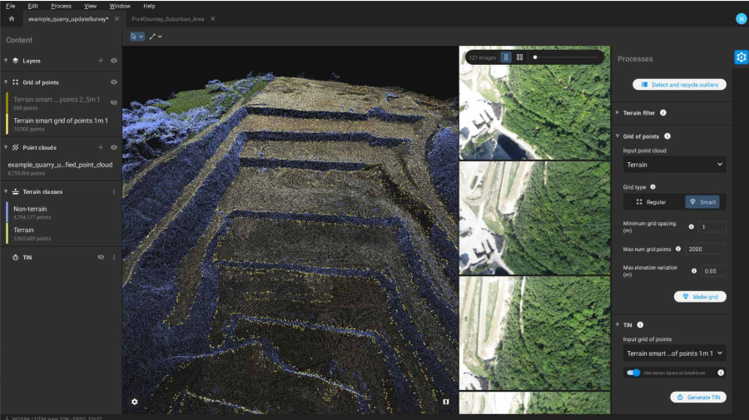
Pix4Dsurvey
Notes:
To begin the restoration process, the team needed a comprehensive understanding of the damage. That’s where Pix4Dsurvey played a crucial role.
This advanced tool creates detailed 3D models of the terrain, offering an accurate representation of the devastation. By integrating data from LiDAR and aerial photographs, it highlights key areas of destruction—cracked roads, collapsed buildings, and unstable foundations.
What makes Pix4Dsurvey invaluable is its ability to provide a clear, visual representation of the earthquake’s impact. This serves as the foundation for planning restoration efforts, enabling the team to prioritize and strategize effectively from the very beginning.

Slide 8
Pix4Dinspect
Purpose: Scans for structural weaknesses in real time.
AI-Driven Analysis:
Identifies fractures in key infrastructure.
Helps prioritize buildings for immediate attention.
Field Utility:
Enables engineers and field workers to use smartphones with LiDAR for documenting damage.
Ensures accurate and real-time assessments.
Impact: Accelerates decision-making for urgent repairs.
Notes:
As the restoration team moved to assess the city, they needed a way to quickly and accurately identify the most critical issues. Pix4Dinspect became their go-to tool for this task.
Using AI-driven analysis, Pix4Dinspect scans for structural weaknesses, such as fractures in key infrastructure, and prioritizes buildings requiring immediate attention. This ensures that resources are directed where they are needed most.
One of its standout features is its field utility. Engineers and field workers can use smartphones equipped with LiDAR to document damage in real time, enabling accurate and on-the-spot assessments.
By accelerating the decision-making process for urgent repairs, Pix4Dinspect proved to be a critical tool in addressing the city’s immediate needs and laying the groundwork for long-term recovery.

Slide 9
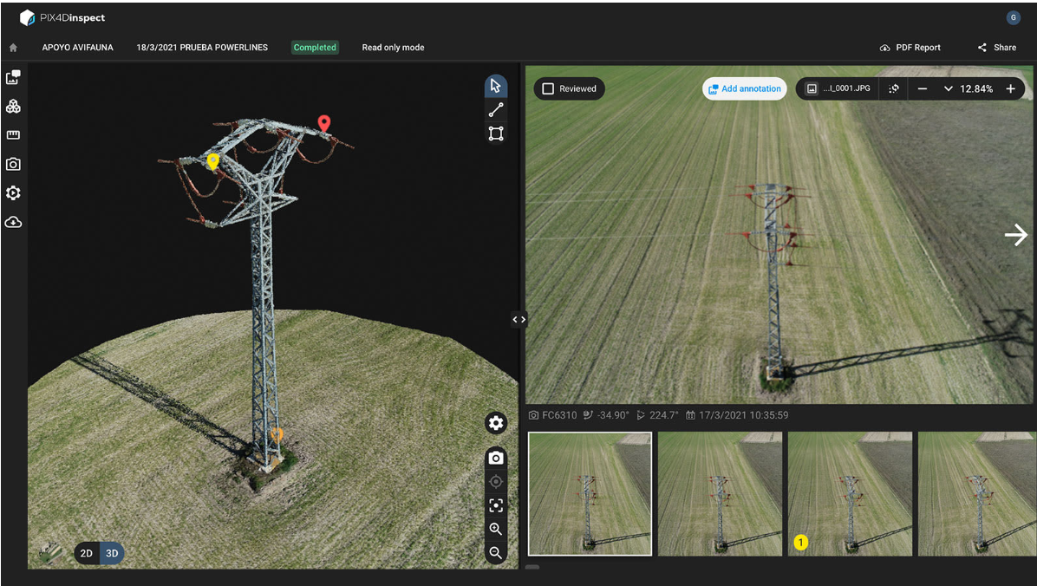
Pix4Dinspect
Notes:
As the restoration team moved to assess the city, they needed a way to quickly and accurately identify the most critical issues. Pix4Dinspect became their go-to tool for this task.
Using AI-driven analysis, Pix4Dinspect scans for structural weaknesses, such as fractures in key infrastructure, and prioritizes buildings requiring immediate attention. This ensures that resources are directed where they are needed most.
One of its standout features is its field utility. Engineers and field workers can use smartphones equipped with LiDAR to document damage in real time, enabling accurate and on-the-spot assessments.
By accelerating the decision-making process for urgent repairs, Pix4Dinspect proved to be a critical tool in addressing the city’s immediate needs and laying the groundwork for long-term recovery.

Slide 10
Pix4Dmatic
Purpose: Processes vast amounts of data to create comprehensive 3D maps.
Speed and Efficiency:
Handles neighborhood-waide mapping in record time.
Processes aerial and ground-level data simultaneously.
AI Assistance:
Offers ideas for earthquake-resistant designs.
Suggests innovative materials and cutting-edge architectural solutions.
Impact: Combines detailed analysis with forward-thinking design insights.
Notes:
To tackle the overwhelming scale of the damage, the team relied on Pix4Dmatic—a tool designed to process vast amounts of data and create comprehensive 3D maps.
Pix4Dmatic’s speed and efficiency are unmatched. It handles neighborhood-wide mapping in record time, seamlessly combining aerial and ground-level data. This allowed the team to get a complete picture of the damage without delays.
What makes Pix4Dmatic truly extraordinary is its AI assistance. It goes beyond analysis to actively contribute to the rebuilding process, offering innovative ideas for earthquake-resistant designs. It even suggests cutting-edge materials and architectural solutions, helping the team imagine a stronger, more resilient future for the city.
By merging detailed analysis with forward-thinking design insights, Pix4Dmatic became a cornerstone of the restoration effort.

Slide 11
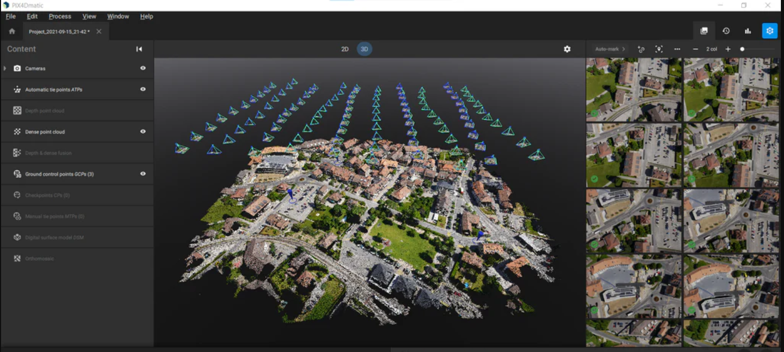
Pix4Dmatic
Notes:
To tackle the overwhelming scale of the damage, the team relied on Pix4Dmatic—a tool designed to process vast amounts of data and create comprehensive 3D maps.
Pix4Dmatic’s speed and efficiency are unmatched. It handles neighborhood-wide mapping in record time, seamlessly combining aerial and ground-level data. This allowed the team to get a complete picture of the damage without delays.
What makes Pix4Dmatic truly extraordinary is its AI assistance. It goes beyond analysis to actively contribute to the rebuilding process, offering innovative ideas for earthquake-resistant designs. It even suggests cutting-edge materials and architectural solutions, helping the team imagine a stronger, more resilient future for the city.
By merging detailed analysis with forward-thinking design insights, Pix4Dmatic became a cornerstone of the restoration effort.

Slide 12
Pix4Dcloud
Purpose: Enables seamless collaboration between team members.
Key Features:
Shares data, 3D models, and design plans across teams.
Provides instant feedback for real-time design adjustments.
Pre- and Post-Quake Comparisons:
AI tools help track changes and ensure alignment with future city needs.
Impact: Enhances teamwork, communication, and decision-making efficiency.
Notes:
Effective collaboration was essential for a project of this scale, and Pix4Dcloud became the team’s central platform for seamless teamwork.
This tool enabled architects, engineers, and government officials to share data, 3D models, and design plans effortlessly. Its real-time capabilities allowed team members to provide instant feedback and make design adjustments on the go.
One of its most impactful features was its ability to compare pre- and post-quake models using AI tools. This helped the team track changes, ensuring that the new designs not only addressed the current damage but aligned with the city’s future needs.
By enhancing teamwork, communication, and decision-making efficiency, Pix4Dcloud transformed the way the team worked together, making the restoration process smoother and more coordinated.

Slide 13
Skills Contribution

Slide 14
Top 10 Skills for Tomorrow
Analytical thinking and innovation
Active learning and learning strategies
Complex problem-solving
Critical thinking and analysis
Creativity, originality and initiative
Leadership and social influence
Technology use, monitoring and control
Technology design and programming
Resilience, stress tolerance and flexibility
Reasoning, problem-solving and ideation

Slide 15
Complex Problem-Solving
Assess widespread damage and set priorities for recovery.
Ensure disaster-proof designs using tools like Pix4Dsurvey.
Create accurate 3D models with LiDAR and aerial imagery.
Identify critical areas with Pix4Dinspect for focused rebuilding.

Slide 16
Technology Use, Monitoring, and Control
Utilize Pix4Dmatic for large-scale data processing.
Facilitate real-time collaboration with Pix4Dcloud.
Monitor reconstruction progress and adjust plans dynamically.
Maintain flexibility with constant feedback loops.

Slide 17
Analytical Thinking and Innovation
Analyze earthquake damage using AI-powered Pix4D tools.
Develop innovative, disaster-resilient design solutions.
Integrate new materials and architectural techniques.
Focus on building a safer, future-ready city.

Slide 18
Creativity, Originality, and Initiative
Design futuristic, earthquake-resistant buildings.
Preserve the city's historical and cultural essence.
Balance innovation with respect for the past.
Turn disaster recovery into an opportunity for architectural advancement.

Slide 19
Resilience, Stress Tolerance, and Flexibility
Work effectively under immense pressure and tight timelines.
Adapt plans with new data from Pix4Dsurvey and Pix4Dinspect.
Maintain high work standards despite evolving challenges.
Show emotional resilience and commitment to success.

Slide 20
Technology Design and Programming
Configure and fine-tune Pix4D’s AI tools.
Optimize tools for urban reconstruction needs.
Ensure precise, fast, and actionable insights from AI.
Highlight technical expertise in leveraging advanced systems.

Slide 21
Reasoning, Problem-Solving, and Ideation
Evaluate structural damage and manage resources efficiently.
Use AI insights from Pix4Dmatic and Pix4Dinspect for decisions.
Simplify complex challenges into practical solutions.
Stay ahead of evolving challenges with swift actions.

Slide 22
Critical Thinking and Analysis
Base decisions on thorough data analysis from Pix4D tools.
Anticipate potential issues to avoid costly mistakes.
Develop well-planned, resilient rebuilding strategies.
Emphasize sound judgment in disaster recovery efforts.

Slide 23
Active Learning and Learning Strategies
Master Pix4Dcloud and other advanced tools.
Adapt to new field data and refine strategies continuously.
Embrace active learning to explore new approaches.
Ensure flexibility and growth in fast-moving environments.

Slide 24
Conclusion
Transform challenges into opportunities for innovation.
Leverage advanced tools for sustainable recovery.
Commit to learning, adaptability, and excellence.
Build a resilient, future-ready urban landscape.

Slide 25
Practical Advice

Slide 26
Complex Problem-Solving
Activities to Try:
Participate in group activities like escape rooms or simulations.
Engage in hackathons to tackle real-world challenges under time pressure.
Skills Gained:
Collaboration under stress.
Strategic thinking and prioritization.
Impact: Learn to solve complicated, time-sensitive problems in practical settings.
Notes:
Complex problem-solving is a vital skill, especially in challenging scenarios like disaster recovery. To develop this, engaging in activities that simulate real-world challenges can be incredibly beneficial.
Consider participating in group activities like escape rooms or simulations that require teamwork and quick decision-making. Hackathons are another excellent option, offering opportunities to tackle real-world problems under time pressure.
Through these activities, you’ll not only learn to collaborate under stress but also hone your strategic thinking and prioritization skills.
The impact? You’ll gain the confidence and ability to solve complicated, time-sensitive problems in practical settings—an essential skill for any professional environment.

Slide 27
Creativity, Originality, and Initiative
Boost Creativity Through:
Brainstorming sessions for innovative solutions.
Design thinking workshops and artistic challenges.
Results:
Develop fresh approaches to tasks and projects.
Cultivate a mindset for innovation and initiative.
Notes:
Creativity is at the heart of problem-solving and innovation. You can boost your creativity by engaging in brainstorming sessions, where you collaborate with others to generate innovative solutions for tasks or challenges.
Participating in design thinking workshops or artistic challenges is another excellent way to enhance your creative abilities. These activities encourage you to think outside the box and approach problems from new perspectives.
The results are transformative: you’ll develop fresh approaches to tasks and projects, and, most importantly, cultivate a mindset that embraces innovation and initiative.
Creativity is not just about art—it’s a valuable skill that drives progress and enables you to create impactful solutions in any field.

Slide 28
Leadership and Social Influence
Ways to Lead:
Take leadership roles in group projects or community efforts.
Join leadership programs or study biographies of influential leaders.
Key Outcomes:
Enhance guidance and team management skills.
Inspire others while improving self-confidence.
Notes:
Leadership is not just about guiding others—it’s about inspiring them and creating a sense of purpose within a team. To build these skills, start by taking leadership roles in group projects or community initiatives. These settings give you hands-on experience in managing teams and driving results.
You can also join leadership programs or delve into the biographies of influential leaders to learn from their experiences and strategies.
The key outcomes? You’ll enhance your ability to guide and manage teams effectively while also boosting your self-confidence.
Strong leadership and social influence aren’t just skills—they’re transformative qualities that help you inspire others and achieve collective goals.

Slide 29
Technology Use, Monitoring, and Control
Keep Updated By:
Taking online courses on AI, automation, or data analytics.
Attending webinars and exploring tutorials on emerging tech.
Advantages:
Gain expertise in monitoring and controlling advanced tools.
Adapt to evolving technological trends effectively.
Notes:
In today’s fast-paced world, staying updated on technological advancements is a game-changer. To build expertise in using and monitoring advanced tools, you can start by exploring online courses on cutting-edge topics like AI, automation, or data analytics.
Webinars and tutorials are also fantastic resources to stay informed about the latest trends and applications in emerging technologies.
The advantages are clear: you’ll develop the skills to monitor and control advanced tools effectively, ensuring you’re always ahead of the curve.
By adapting to evolving tech trends, you’ll not only enhance your professional capabilities but also position yourself as a valuable asset in any industry.

Slide 30
Resilience, Stress Tolerance, and Flexibility
Develop Resilience Through:
Practicing mindfulness and stress management.
Engaging in high-pressure situations like sports or public speaking.
Benefits:
Adaptability in challenging circumstances.
Improved emotional and time management skills.
Notes:
Resilience is the ability to adapt and thrive in challenging situations—a skill that’s essential in both personal and professional life. You can develop resilience by practicing mindfulness and effective stress management techniques, which help maintain emotional balance under pressure.
Additionally, engaging in high-pressure activities like sports or public speaking provides valuable opportunities to build confidence and adaptability in demanding circumstances.
The benefits of developing resilience are profound: you’ll become more adaptable when facing unexpected challenges and improve your emotional and time management skills.
Resilience is not just about enduring difficulties—it’s about growing stronger through them, ensuring you’re ready to tackle whatever comes your way

Slide 31
Systems Analysis and Evaluation
Learn Through:
Breaking down complex processes (logistics, design, or planning).
Working on projects like urban planning simulations or network analysis.
Results:
Understand system interactions and dependencies.
Create efficient, holistic solutions for real-world systems.
Notes:
To excel in systems analysis, start by breaking down complex processes—whether it’s logistics, design, or planning. Understanding how different parts of a system interact is key to identifying challenges and opportunities.
Engage in projects like urban planning simulations or network analysis. These hands-on experiences allow you to see system interactions in action, providing valuable insights into dependencies and dynamics.
The results are transformative: you’ll gain a deep understanding of how systems work, enabling you to create efficient, holistic solutions for real-world challenges.
By developing these skills, you’ll not only solve problems effectively but also design systems that are both innovative and sustainable.

Slide 32
Thank you !

